Slide 1
RTOS REVIEW
COURSE PROJECT
CAR PARKING BARRICADE SYSTEM
NAME | ROLL NO.
Rahul Sajjan | 121
Vinayak Bhajantri | 125
Vinayak Jainapur | 140
Abdul Razzak R Yergatti | 142
RTOS Team F11

Slide 2
PROBLEM STATEMENT
In Car Parking lots and Parking Garages, entry is controlled using barrier systems. The barrier must not be lowered when there is a vehicle underneath. Devise a system to implement the same on Cortex M3 board (LPC 1768).

Slide 3
PERIPHERALS USED AND ITS SPECIFICATIONS
ON-CHIP PERIPHERALS
RTC
An ultra-low power 32 kHz oscillator will provide a 1 Hz clock to the time counting portion of the RTC.
The RTC includes an alarm function that can wake up the LPC17xx from all reduced power modes with a time resolution of 1 s.
Dedicated power supply pin can be connected to a battery or to the main 3.3 V. RTC power supply is isolated from the rest of the chip.
Measures the passage of time to maintain a calendar and clock.
• Dedicated power supply pin can be connected to a battery or to the main 3.3 V.
• Periodic interrupts can be generated from increments of any field of the time registers.
• Backup registers (20 bytes) powered by VBAT.

Slide 4
PERIPHERALS USED AND ITS SPECIFICATIONS
UART
The board has an RS-232 serial communication port.
The RS-232 transmits and receives signals that appear on the female 9-pin DB connectors (DB3).
It uses a standard RS-232 cross cable to connect the board to the computer's serial port.
The controller U1 provides serial I/O data at TTL levels to the MAX232 (U13) device, which in turn converts the logic value to the appropriate RS-232 voltage level.

Slide 5
PERIPHERALS USED AND ITS SPECIFICATIONS
LCD
The operating voltage of this display ranges from 4.7V to 5.3V
The display bezel is 72 x 25mm
The operating current is 1mA without a backlight
PCB size of the module is 80L x 36W x 10H mm
LED color for backlight is green or blue
Number of columns – 16
Number of rows – 2
Characters – 32
It works in 4-bit and 8-bit modes

Slide 6
PERIPHERALS USED AND ITS SPECIFICATIONS
OFF-CHIP PERIPHERALS
ULTRASONIC SENSOR
Supply voltage: 5V (DC)
Supply current: 15mA
Modulation frequency: 40Hz
Output: 0–5V
Beam angle: Max 15 degrees
Distance: 2 cm–400 cm
Accuracy: 0.3 cm
Communication: Positive TTL pulse
STEPPER MOTOR
Rated voltage: 5V DC
Reduction Ratio: 64:1
Step Angle: 5.625° /64
Self-positioning Torque: >34.3mN.m
Friction torque: 600-1200 gf.cm.

Slide 7
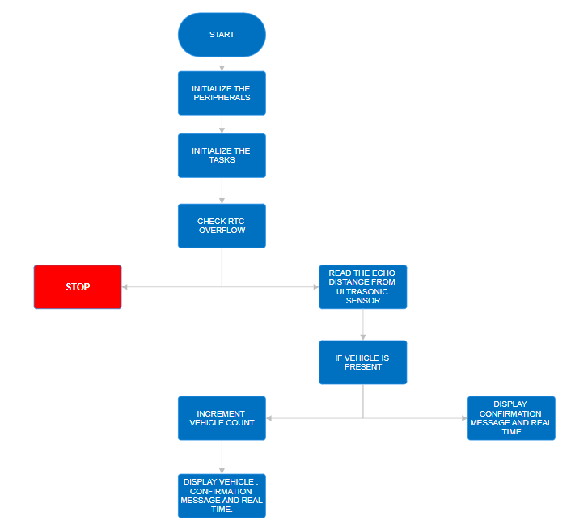
FLOWCHART
YES
NO
YES
NO

Slide 8
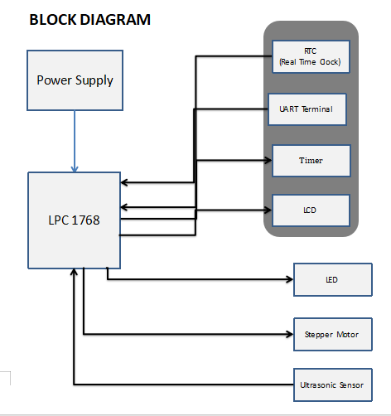
BLOCK DIAGRAM

Slide 9
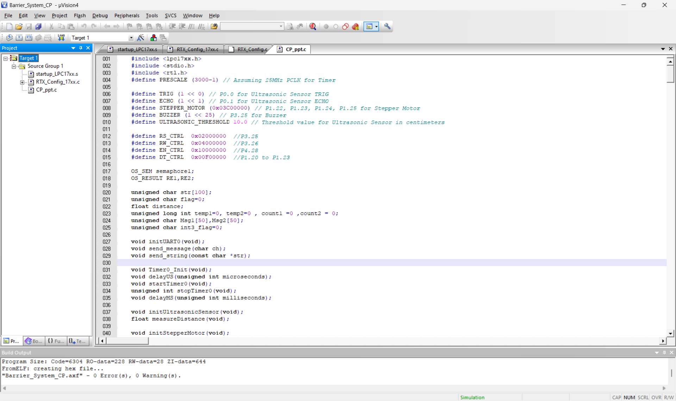
PROGRAM

Slide 10
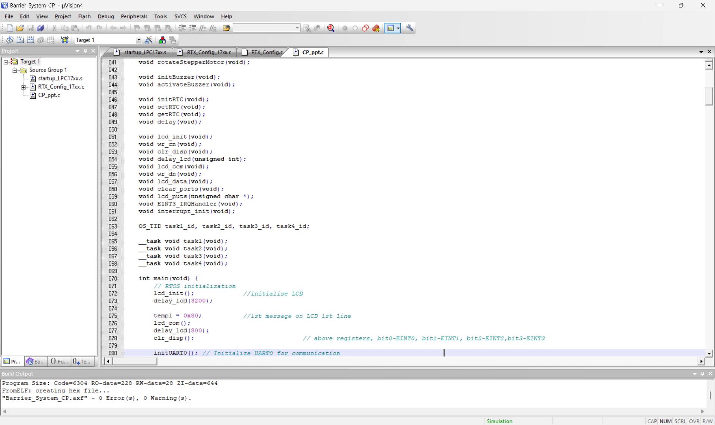
PROGRAM

Slide 11
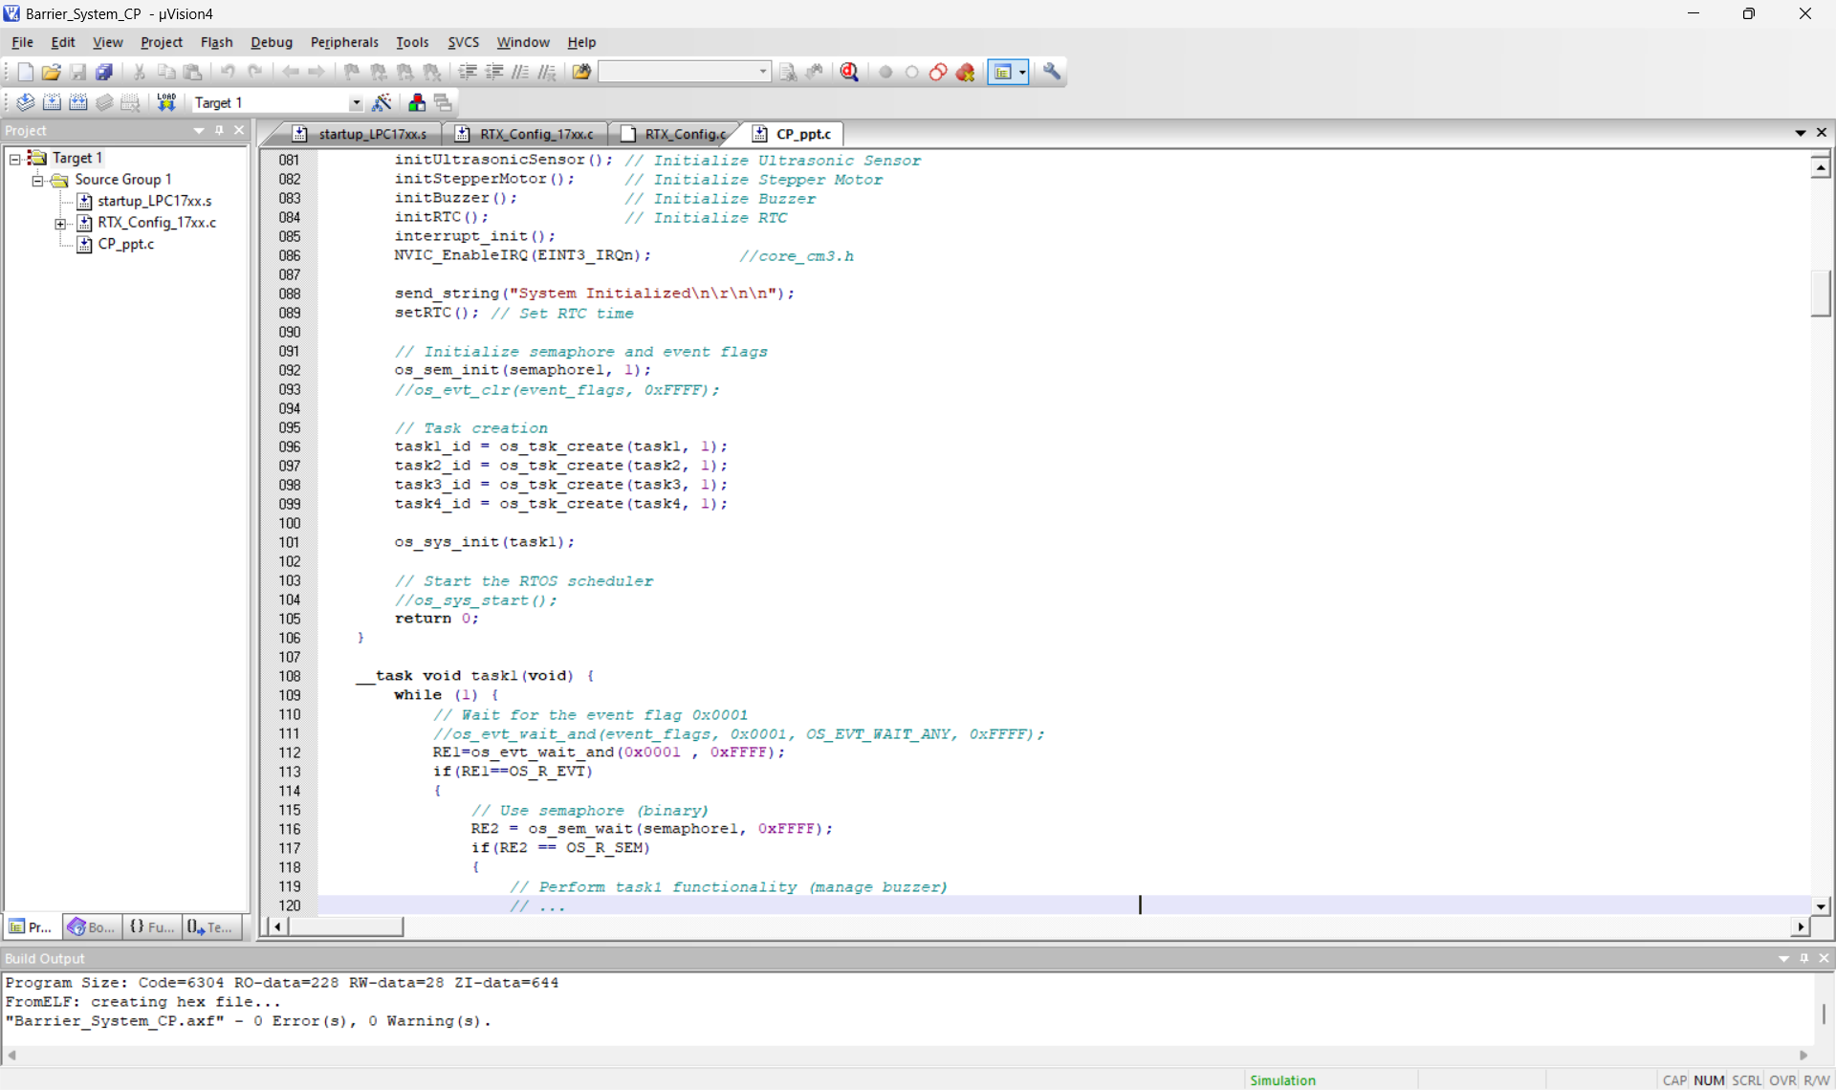
PROGRAM

Slide 12
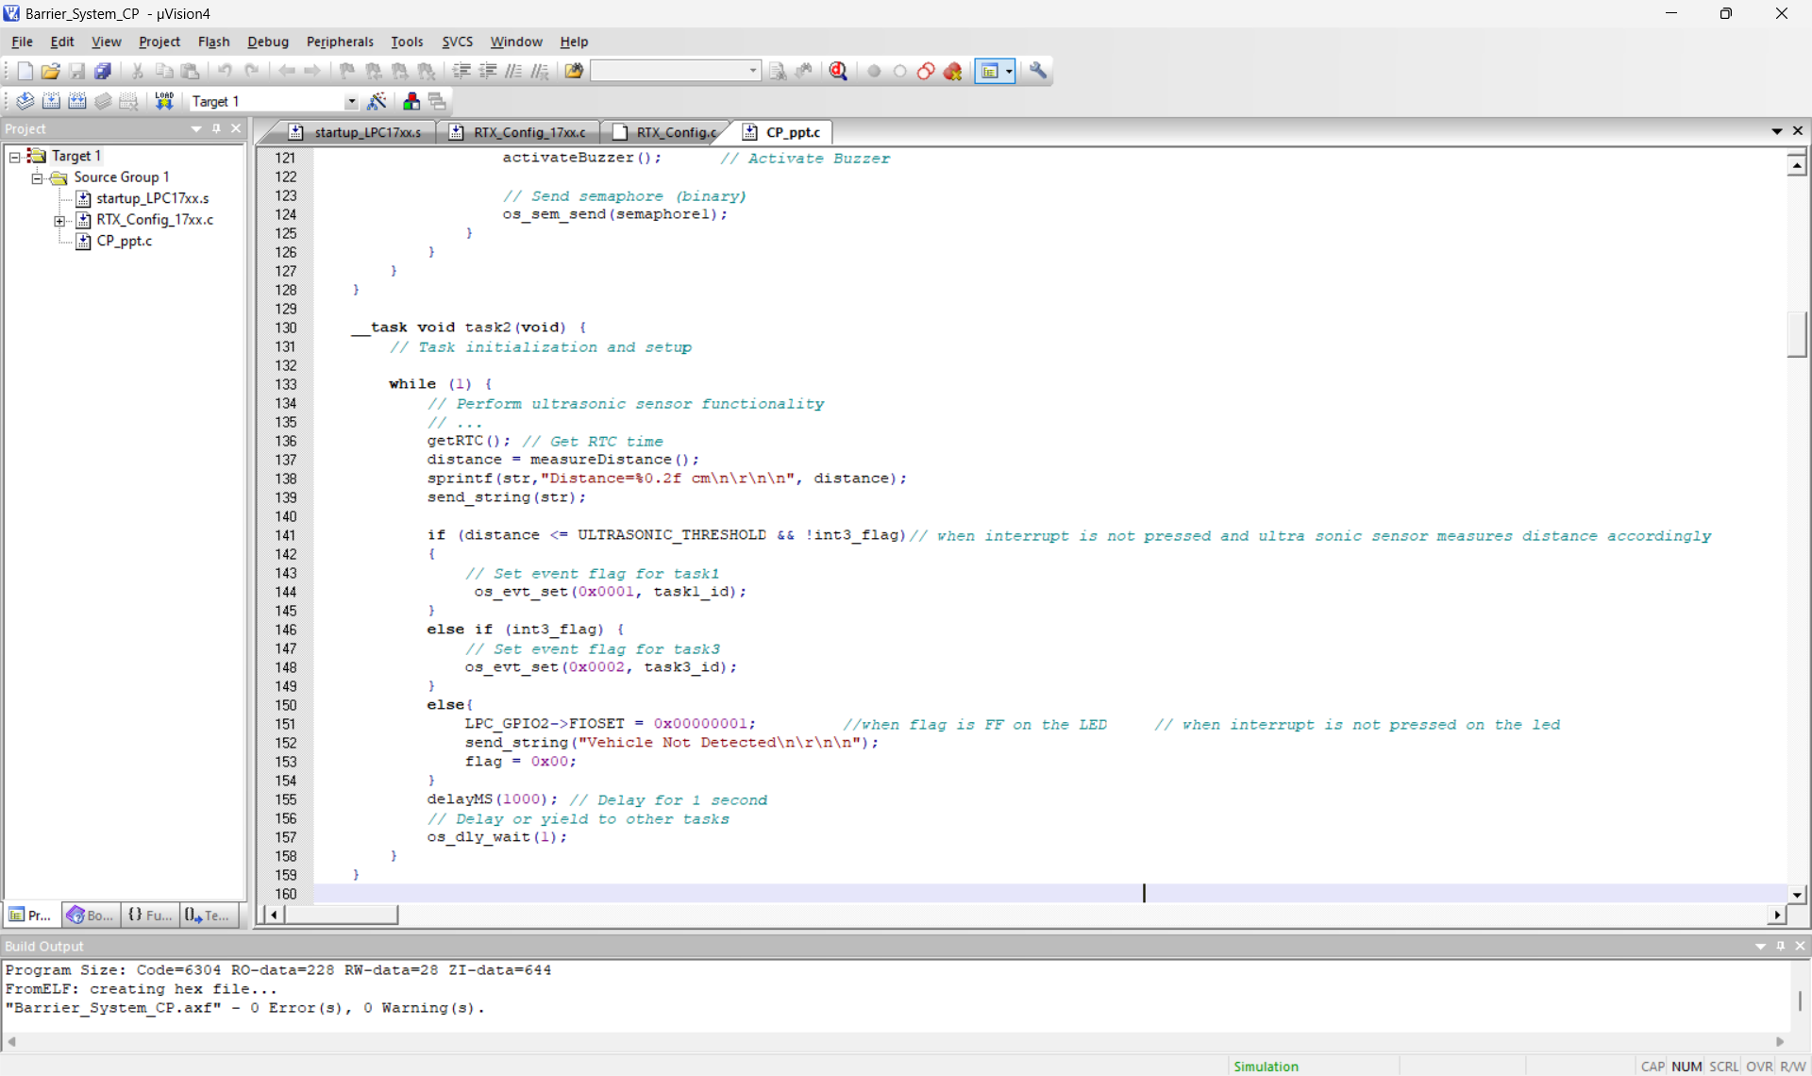
PROGRAM

Slide 13
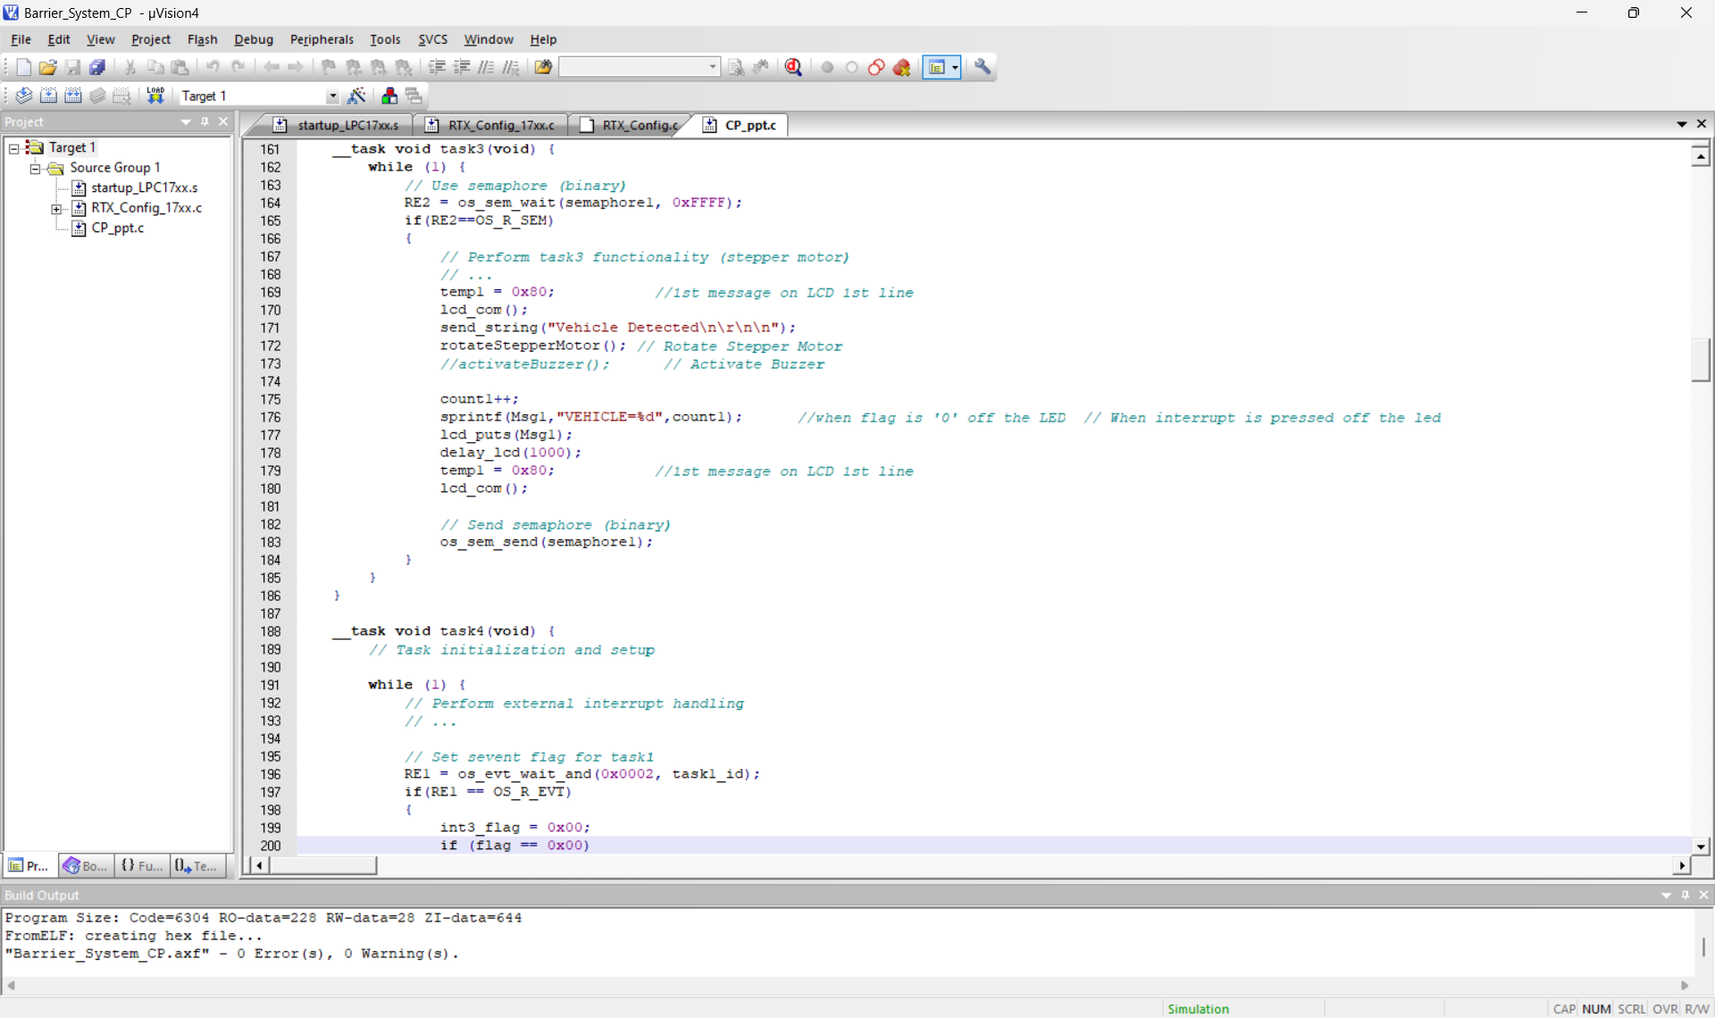
PROGRAM

Slide 14
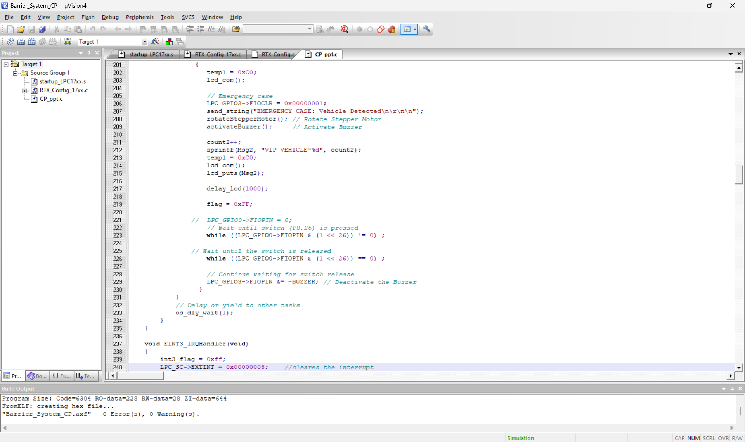
PROGRAM

Slide 15
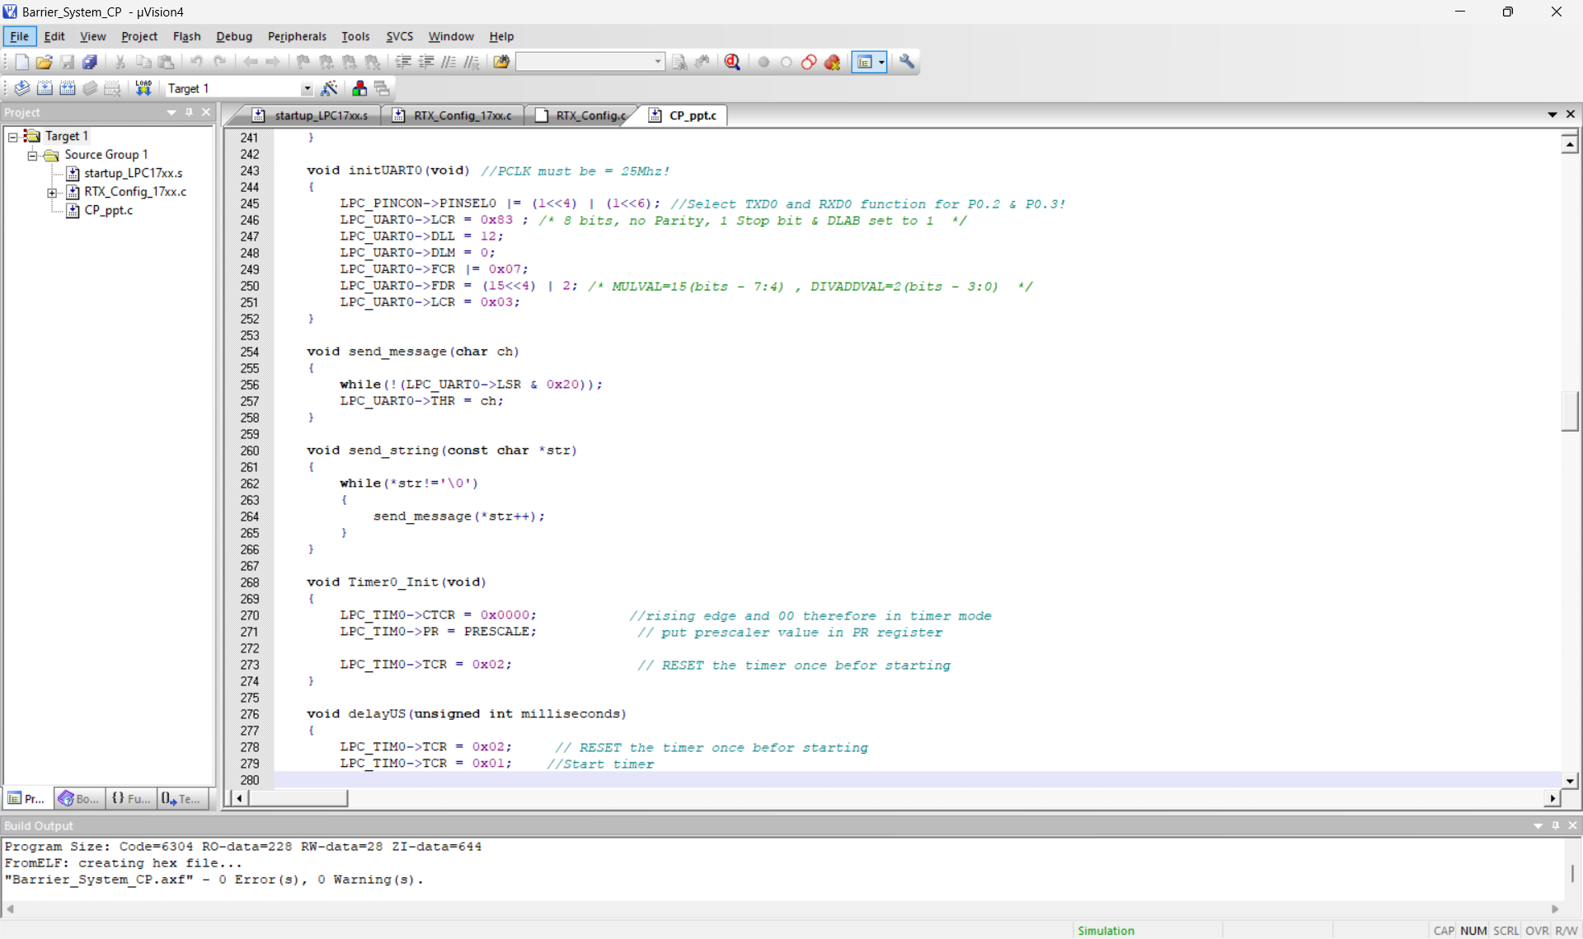
PROGRAM

Slide 16
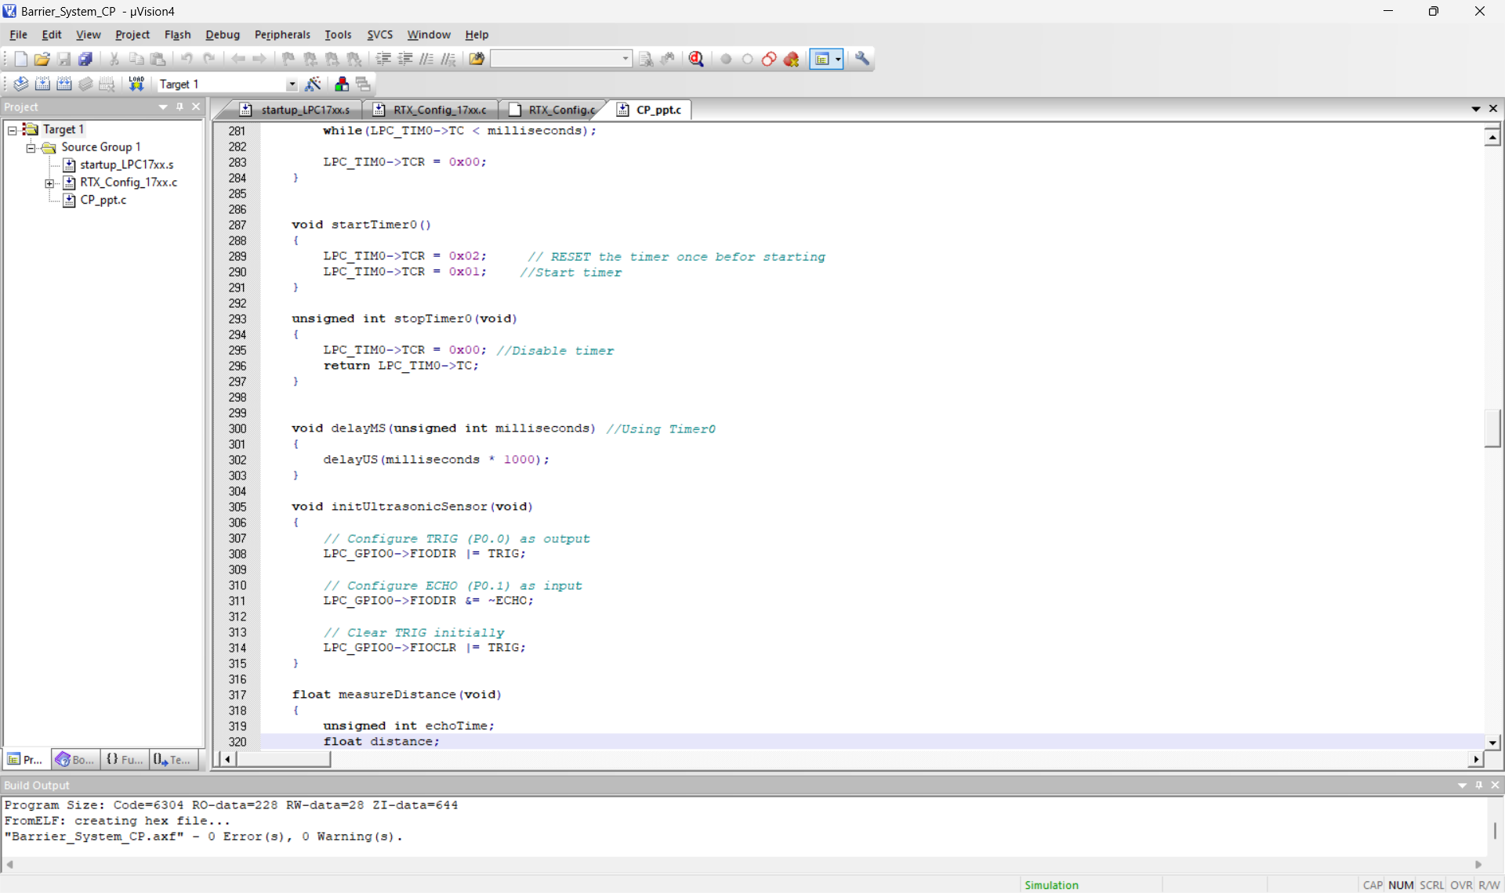
PROGRAM

Slide 17
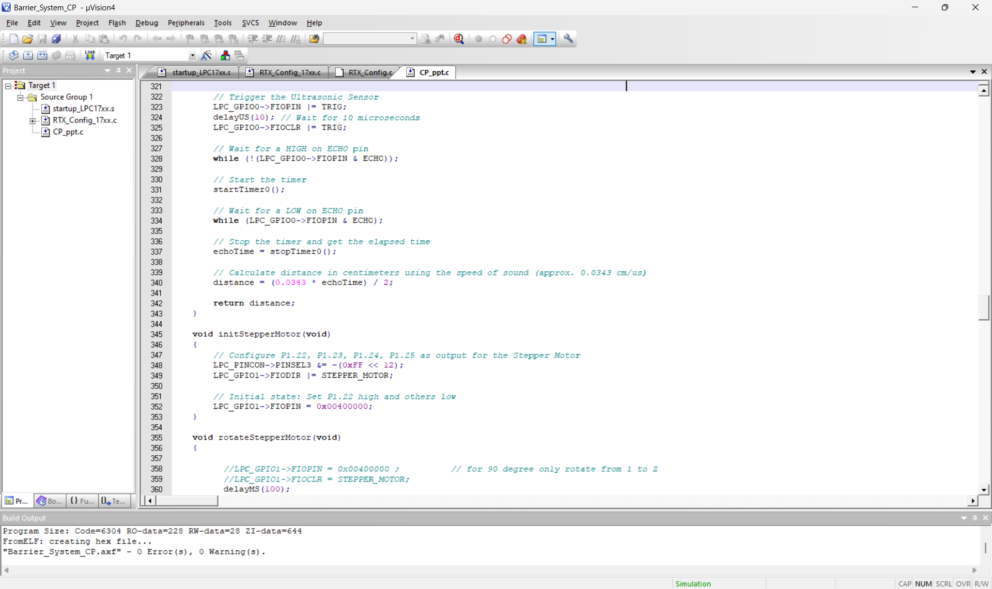
PROGRAM

Slide 18
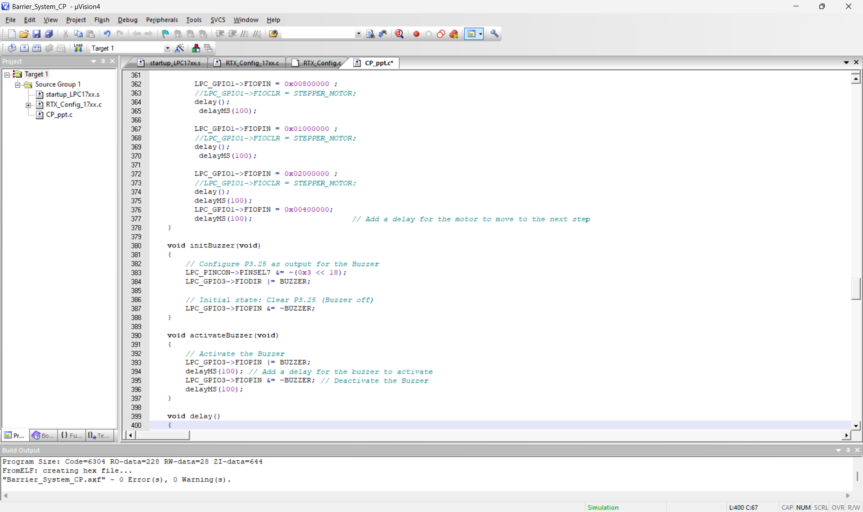
PROGRAM

Slide 19
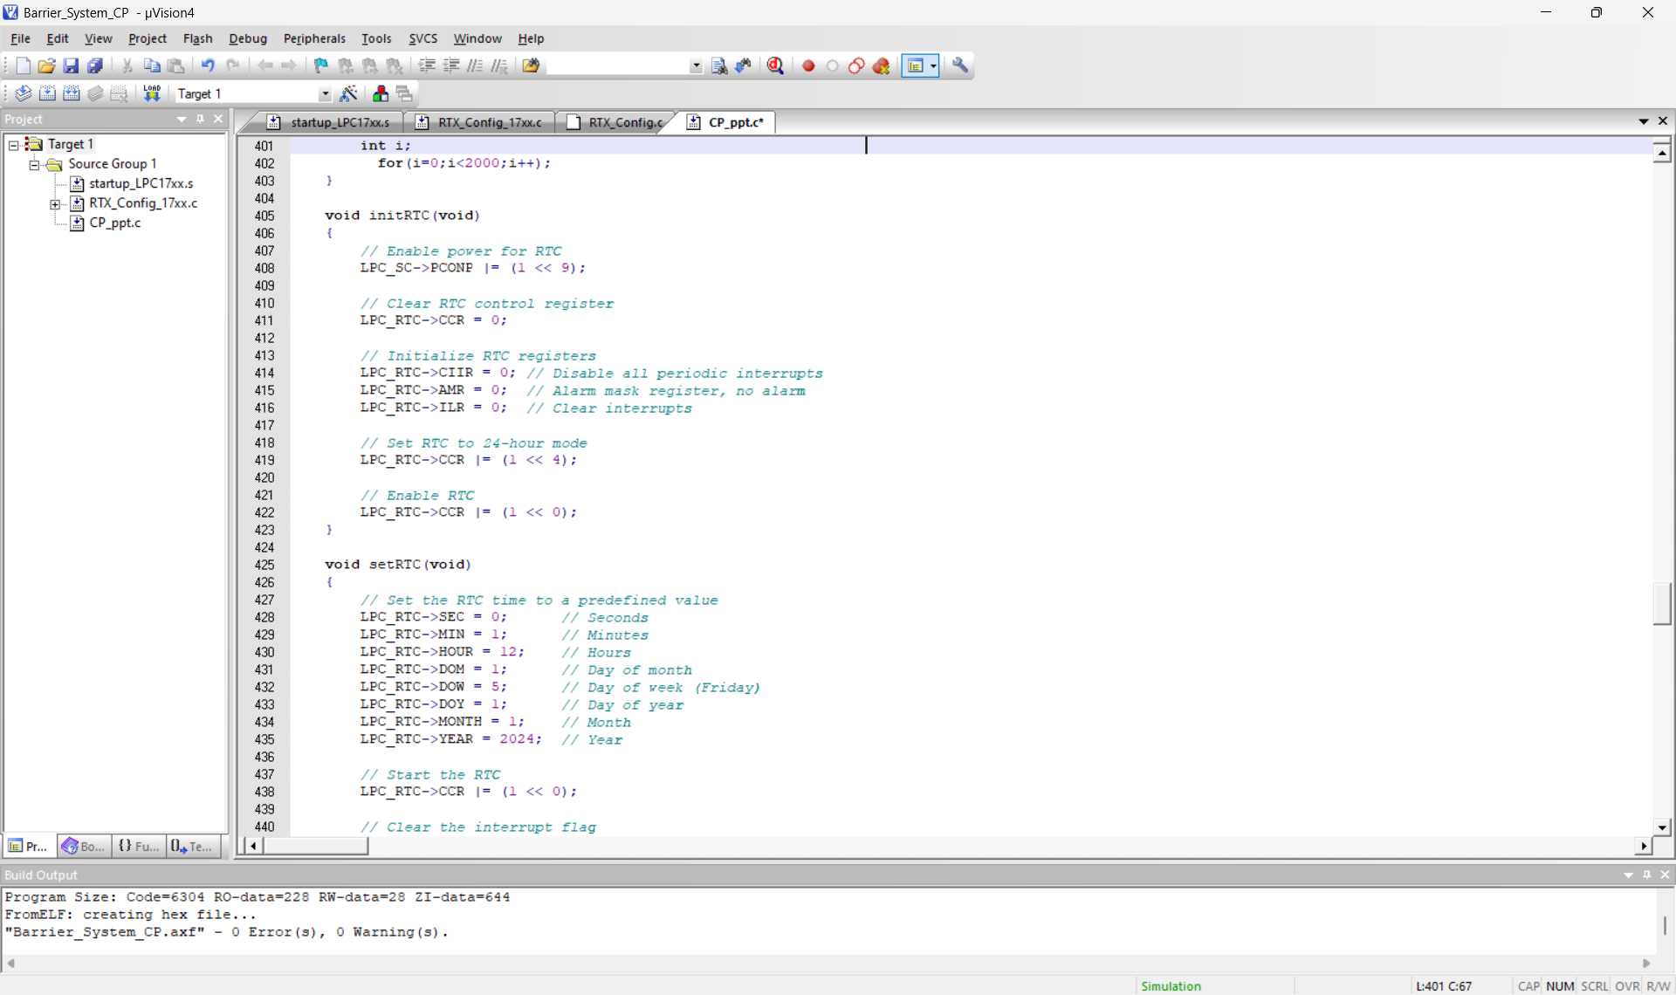
PROGRAM

Slide 20
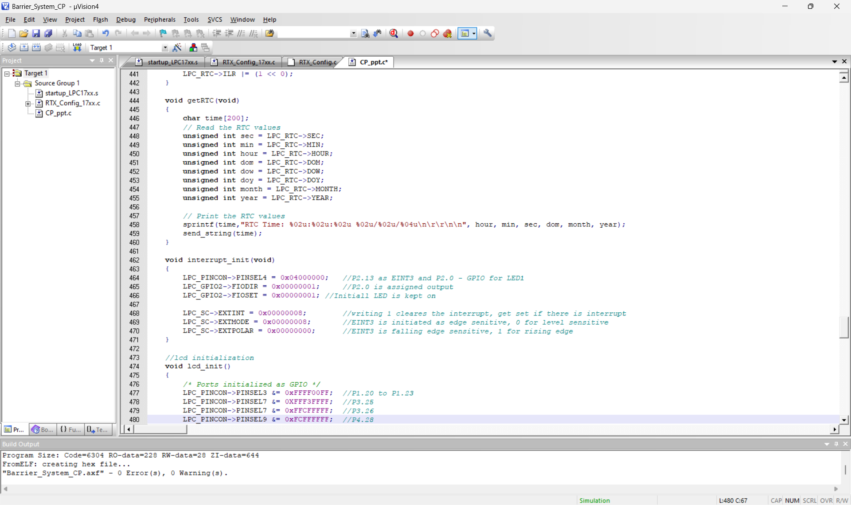
PROGRAM

Slide 21
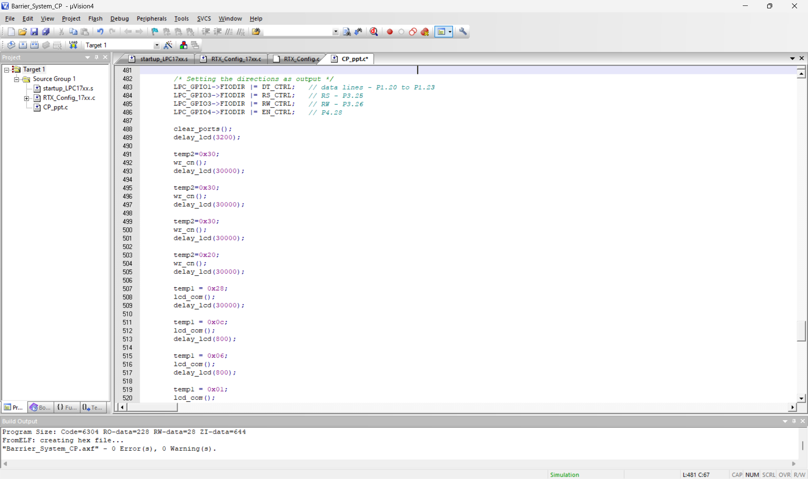
PROGRAM

Slide 22
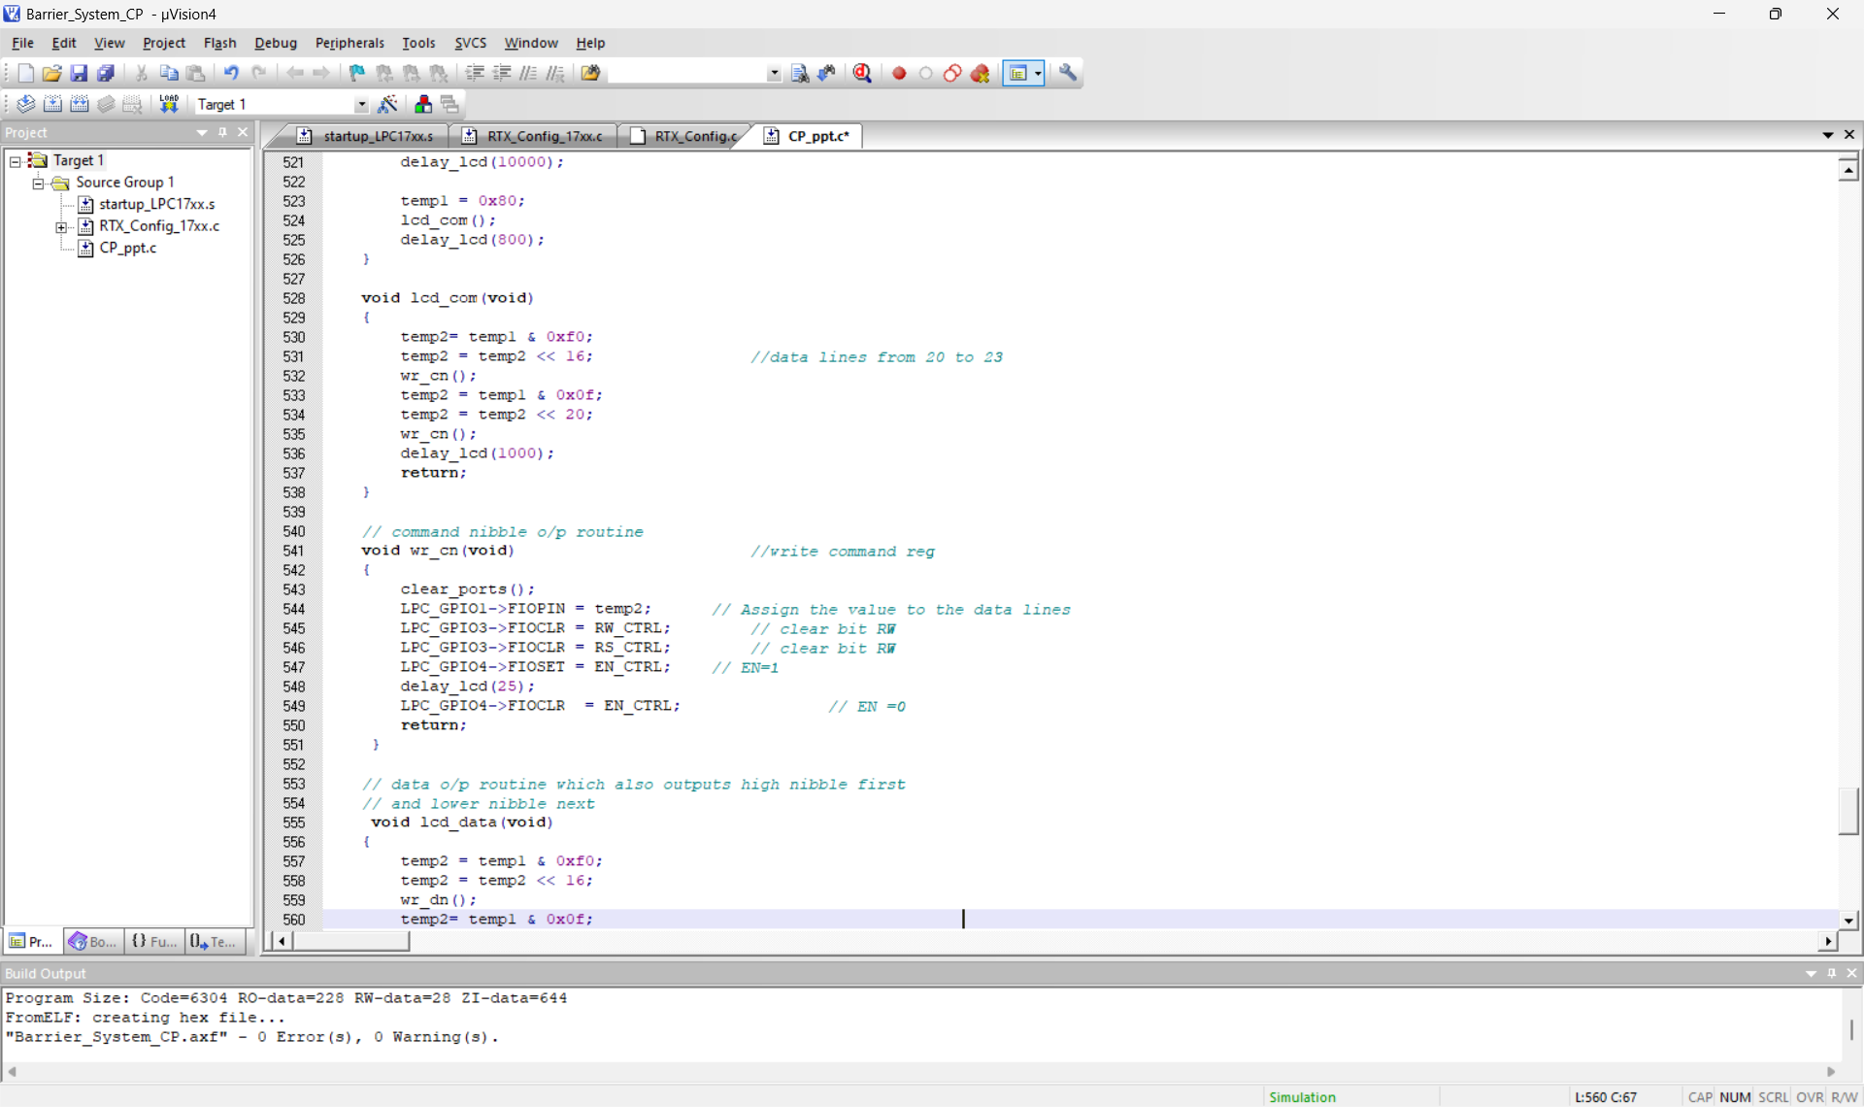
PROGRAM

Slide 23
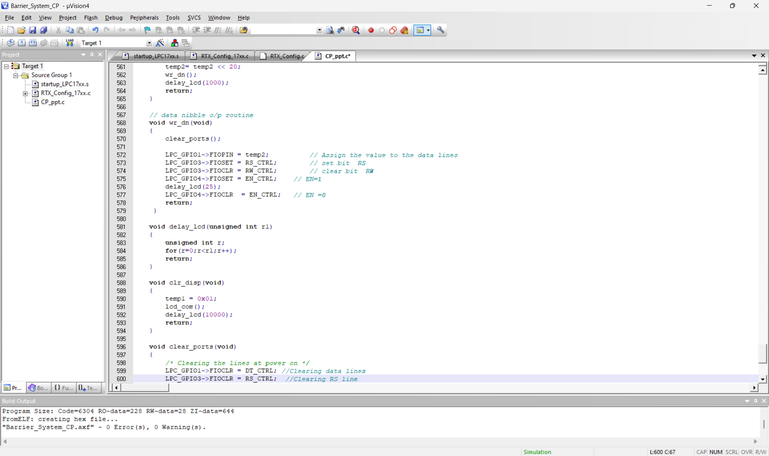
PROGRAM

Slide 24
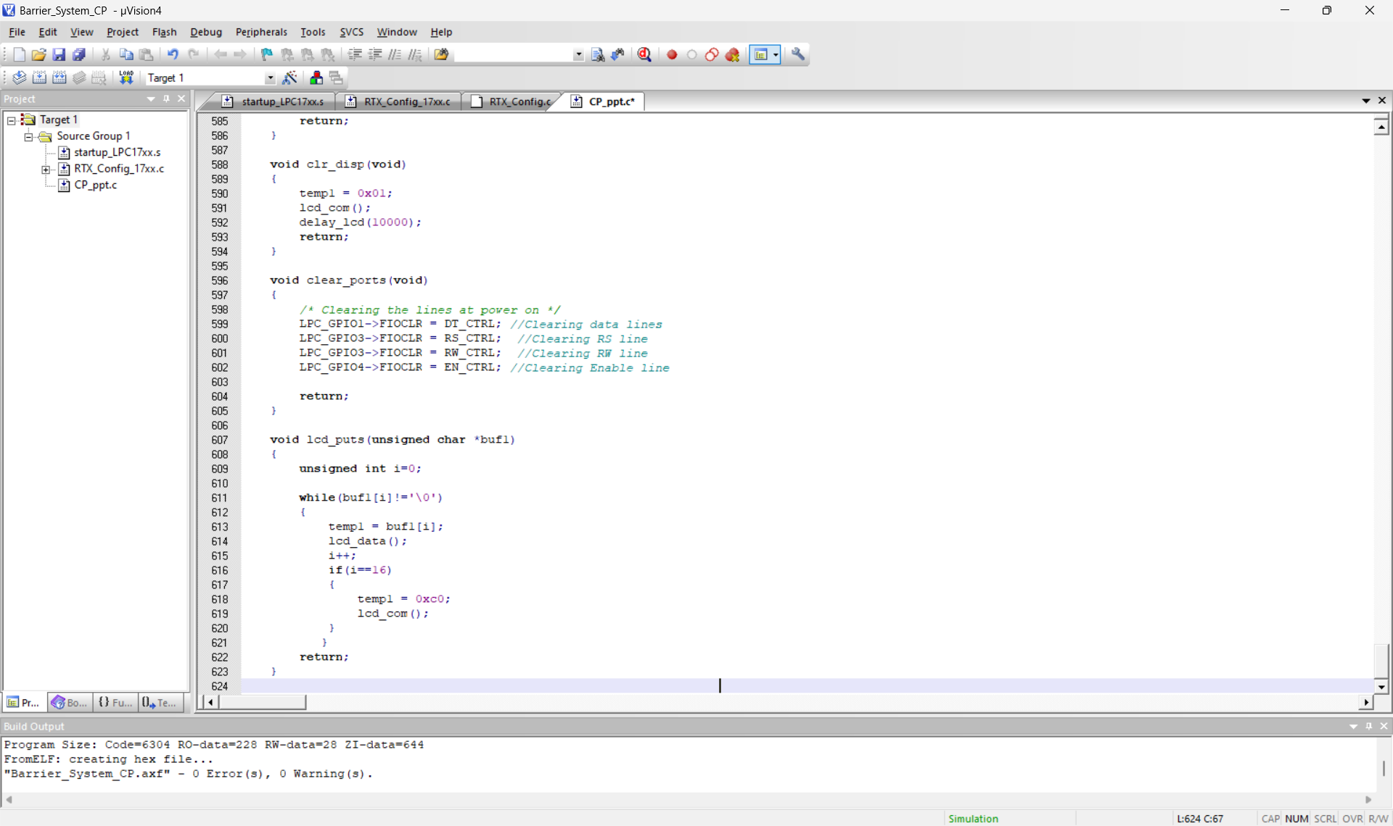
PROGRAM

Slide 25
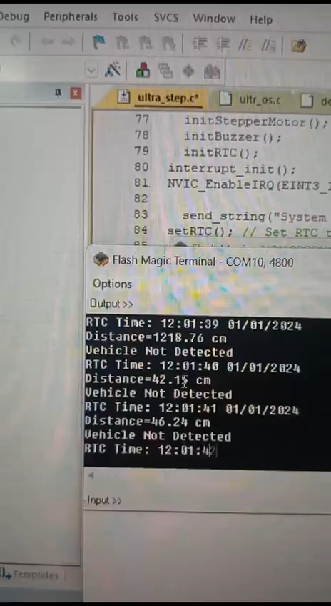
RESULTS VIDEO

Slide 26
THANK YOU
RTOS Team F11

